Slide 1
NAME – NITIKA
CLASS – 26BAH216
UID – 26BAI10026
FACULTY – TANISH PARMAR
LTPS MINI PROJECT · C PROGRAMMING
Smart Parking Management System Using C
A simple, structured approach to parking records, slot allocation, and everyday control.

Slide 2

INTRODUCTION AND PROBLEM
Parking becomes easier when records and spaces stay organized
Computer-based parking management improves organization and efficiency by keeping records and slot status up to date.
Manual tracking of vehicles is slow and error-prone
Drivers waste time searching for vacant slots
Vehicle records are hard to maintain
Parking fees must be calculated consistently
LTPS Mini Project | C Programming
02

Slide 3
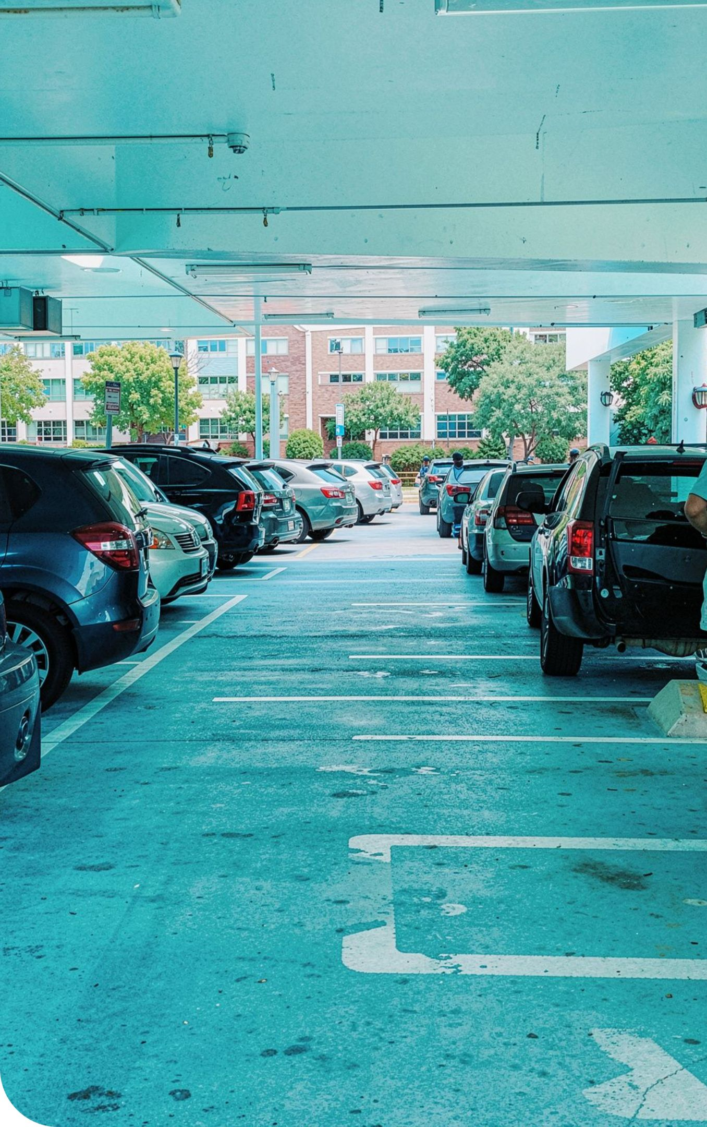
PROJECT OBJECTIVES AND FEATURES
Accurate, organized parking control with ten slots
Automatic slot allocation
Ten slots for three vehicle categories are assigned automatically.
Entry, exit, and search
Vehicles are recorded on entry and exit, with duplicate checking and quick search.
Billing and occupancy reports
Parking fees are calculated at exit and occupancy reports show the current state.
03

Slide 4




TECHNOLOGY AND CONCEPTS
Technology and concepts used in the system
C language and structures
Functions and strings
Structures model vehicle records; arrays represent the ten slots.
Functions and strings organize registration, search, and billing.
Pointers, loops, and conditions
File handling
Pointers, loops, and conditional statements drive each operation.
File handling preserves records between sessions.
04

Slide 5
SYSTEM FEATURES
Core features cover the full parking cycle
Vehicle entry and exit
Slot allocation
Record each vehicle on arrival and departure.
Assign a free slot automatically from the ten available.
Vehicle search
Occupancy report
Find any parked vehicle by its number.
Show which slots are occupied and which are free.
Fee calculation
Saving records
Compute the parking fee at exit from the time parked.
Store vehicle records so they persist between sessions.
05

Slide 6
SYSTEM WORKFLOW
Every parking action follows a predictable workflow
Start →
Load records →
Display menu →
Select operation
Process request →
Save records →
Exit
A repeatable sequence keeps records current.
06

Slide 7
PROGRAM IMPLEMENTATION · FULL SOURCE CODE
Full Source Code — Part 1 of 2
Part 1 of 2 · lines 1–64
Part 1 of 2 · lines 65–128
Part 1 of 2 · lines 129–192
#include <stdio.h>
#include <string.h>
#include <time.h>
#include <ctype.h>
#define MAX_SLOTS 10
#define NUMBER_LENGTH 20
#define DATA_FILE "parking.dat"
typedef struct {
char vehicleNumber[NUMBER_LENGTH];
int vehicleType; /* 1 = Bike, 2 = Car, 3 = Truck */
time_t entryTime;
int occupied;
} Vehicle;
Vehicle parking[MAX_SLOTS];
/* Function declarations */
void initializeParking(void);
void loadData(void);
void saveData(void);
void displayMenu(void);
void showSlots(void);
void parkVehicle(void);
void removeVehicle(void);
void searchVehicle(void);
void showReport(void);
int findVehicle(const char number[]);
int getFreeSlot(void);
int getVehicleType(void);
void readVehicleNumber(char number[]);
double calculateFee(int type, time_t entry, time_t exitTime);
void clearInput(void);
void printVehicleType(int type);
int main(void) {
int choice;
initializeParking();
loadData();
do {
displayMenu();
printf("Enter your choice: ");
if (scanf("%d", &choice) != 1) {
printf("Invalid input. Please enter a number.\n");
clearInput();
continue;
}
clearInput();
switch (choice) {
case 1:
showSlots();
break;
case 2:
parkVehicle();
break;
case 3:
removeVehicle();
break;
case 4:
searchVehicle();
break;
case 5:
showReport();
break;
case 6:
saveData();
printf("Data saved. Thank you!\n");
break;
default:
printf("Invalid choice. Select 1 to 6.\n");
}
} while (choice != 6);
return 0;
}
void initializeParking(void) {
int i;
for (i = 0; i < MAX_SLOTS; i++) {
parking[i].vehicleNumber[0] = '\0';
parking[i].vehicleType = 0;
parking[i].entryTime = (time_t)0;
parking[i].occupied = 0;
}
}
void loadData(void) {
FILE *fp = fopen(DATA_FILE, "rb");
if (fp == NULL) {
printf("No previous data found. Starting fresh.\n");
return;
}
if (fread(parking, sizeof(Vehicle), MAX_SLOTS, fp)
!= MAX_SLOTS) {
printf("Warning: Saved data could not be fully loaded.\n");
initializeParking();
} else {
printf("Previous parking records loaded.\n");
}
fclose(fp);
}
void saveData(void) {
FILE *fp = fopen(DATA_FILE, "wb");
if (fp == NULL) {
printf("Error: Unable to save parking data.\n");
return;
}
if (fwrite(parking, sizeof(Vehicle), MAX_SLOTS, fp)
!= MAX_SLOTS) {
printf("Error while writing parking data.\n");
}
fclose(fp);
}
void displayMenu(void) {
printf("\n====================================\n");
printf(" SMART PARKING MANAGEMENT SYSTEM\n");
printf("====================================\n");
printf("1. View parking slots\n");
printf("2. Park a vehicle\n");
printf("3. Remove a vehicle and calculate fee\n");
printf("4. Search for a vehicle\n");
printf("5. Parking report\n");
printf("6. Save data and exit\n");
printf("====================================\n");
}
void printVehicleType(int type) {
switch (type) {
case 1: printf("Bike"); break;
case 2: printf("Car"); break;
case 3: printf("Truck"); break;
default: printf("Unknown"); break;
}
}
void showSlots(void) {
int i, available = 0;
printf("\n--- PARKING SLOT STATUS ---\n");
for (i = 0; i < MAX_SLOTS; i++) {
printf("Slot %d: ", i + 1);
if (parking[i].occupied) {
printf("Occupied | %s | ",
parking[i].vehicleNumber);
printVehicleType(parking[i].vehicleType);
printf("\n");
} else {
printf("Available\n");
available++;
}
}
printf("Available slots: %d/%d\n",
available, MAX_SLOTS);
}
void readVehicleNumber(char number[]) {
size_t i, len;
printf("Enter vehicle registration number: ");
fgets(number, NUMBER_LENGTH, stdin);
len = strlen(number);
if (len > 0 && number[len - 1] == '\n') {
number[len - 1] = '\0';
} else {
clearInput();
}
/* Convert registration to uppercase */
for (i = 0; number[i] != '\0'; i++) {
number[i] = (char)toupper((unsigned char)number[i]);
}
}
07

Slide 8
PROGRAM IMPLEMENTATION · FULL SOURCE CODE
Full Source Code — Part 2 of 2
Part 2 of 2 · lines 193–256
Part 2 of 2 · lines 257–320
Part 2 of 2 · lines 321–387
int getVehicleType(void) {
int type;
printf("Vehicle type:\n");
printf("1. Bike (Rs. 20 per hour)\n");
printf("2. Car (Rs. 50 per hour)\n");
printf("3. Truck (Rs. 80 per hour)\n");
printf("Select type: ");
if (scanf("%d", &type) != 1) {
clearInput();
return 0;
}
clearInput();
if (type < 1 || type > 3) {
return 0;
}
return type;
}
int findVehicle(const char number[]) {
int i;
for (i = 0; i < MAX_SLOTS; i++) {
if (parking[i].occupied &&
strcmp(parking[i].vehicleNumber, number) == 0) {
return i;
}
}
return -1;
}
int getFreeSlot(void) {
int i;
for (i = 0; i < MAX_SLOTS; i++) {
if (!parking[i].occupied) {
return i;
}
}
return -1;
}
void parkVehicle(void) {
char number[NUMBER_LENGTH];
int slot, type;
slot = getFreeSlot();
if (slot == -1) {
printf("Parking is full. No slots available.\n");
return;
}
readVehicleNumber(number);
if (number[0] == '\0') {
printf("Registration number cannot be empty.\n");
return;
}
if (findVehicle(number) != -1) {
printf("This vehicle is already parked.\n");
return;
}
type = getVehicleType();
if (type == 0) {
printf("Invalid vehicle type.\n");
return;
}
strncpy(parking[slot].vehicleNumber, number,
NUMBER_LENGTH - 1);
parking[slot].vehicleNumber[NUMBER_LENGTH - 1] = '\0';
parking[slot].vehicleType = type;
parking[slot].entryTime = time(NULL);
parking[slot].occupied = 1;
saveData();
printf("\nVehicle parked successfully!\n");
printf("Assigned slot: %d\n", slot + 1);
printf("Entry time: %s", ctime(&parking[slot].entryTime));
}
double calculateFee(int type, time_t entry, time_t exitTime) {
double seconds = difftime(exitTime, entry);
int hours = (int)(seconds / 3600.0);
/* Round any partial hour up; minimum charge is one hour */
if (seconds > hours * 3600.0) {
hours++;
}
if (hours < 1) {
hours = 1;
}
switch (type) {
case 1: return hours * 20.0;
case 2: return hours * 50.0;
case 3: return hours * 80.0;
default: return 0.0;
}
}
void removeVehicle(void) {
char number[NUMBER_LENGTH];
int index, slot;
time_t exitTime;
double fee;
readVehicleNumber(number);
index = findVehicle(number);
if (index == -1) {
printf("Vehicle not found in the parking lot.\n");
return;
}
exitTime = time(NULL);
fee = calculateFee(parking[index].vehicleType,
parking[index].entryTime, exitTime);
slot = index + 1;
printf("\n--- PARKING BILL ---\n");
printf("Vehicle: %s\n", parking[index].vehicleNumber);
printf("Slot: %d\n", slot);
printf("Type: ");
printVehicleType(parking[index].vehicleType);
printf("\nEntry time: %s",
ctime(&parking[index].entryTime));
printf("Exit time: %s", ctime(&exitTime));
printf("Parking fee: Rs. %.2f\n", fee);
parking[index].occupied = 0;
parking[index].vehicleNumber[0] = '\0';
parking[index].vehicleType = 0;
parking[index].entryTime = (time_t)0;
saveData();
printf("Vehicle removed. Slot %d is now available.\n", slot);
}
void searchVehicle(void) {
char number[NUMBER_LENGTH];
int index;
readVehicleNumber(number);
index = findVehicle(number);
if (index == -1) {
printf("Vehicle not found.\n");
} else {
printf("\nVehicle found!\n");
printf("Registration: %s\n",
parking[index].vehicleNumber);
printf("Slot: %d\n", index + 1);
printf("Type: ");
printVehicleType(parking[index].vehicleType);
printf("\nEntry time: %s",
ctime(&parking[index].entryTime));
}
}
void showReport(void) {
int i, occupied = 0;
printf("\n--- PARKING REPORT ---\n");
for (i = 0; i < MAX_SLOTS; i++) {
if (parking[i].occupied) {
occupied++;
}
}
printf("Total slots: %d\n", MAX_SLOTS);
printf("Occupied slots: %d\n", occupied);
printf("Available slots: %d\n", MAX_SLOTS - occupied);
printf("Occupancy: %.1f%%\n",
occupied * 100.0 / MAX_SLOTS);
}
void clearInput(void) {
int ch;
while ((ch = getchar()) != '\n' && ch != EOF) {
/* Discard remaining input */
}
}
08

Slide 9
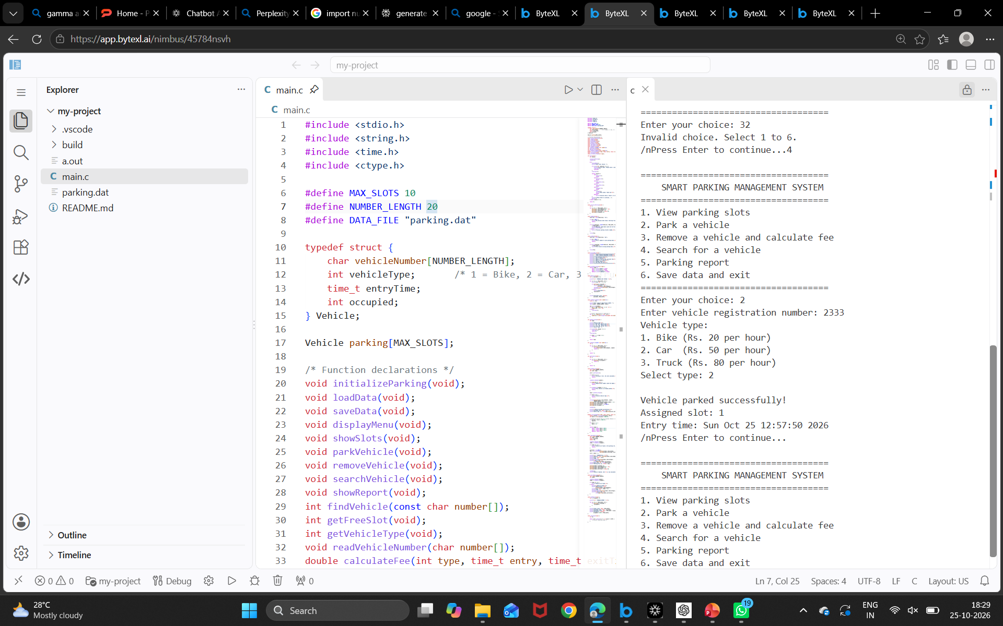

Slide 10
How to compile and run
You can use GCC, Code::Blocks, or another C compiler.
Copy the program into a file named smart_parking.c.
In main(), initialize the menu variable as int choice = 0; so the loop also behaves safely after invalid input.
Open a terminal in the folder containing the file.
Compile and run it:
gcc smart_parking.c -o smart_parking
./smart_parking

Slide 11
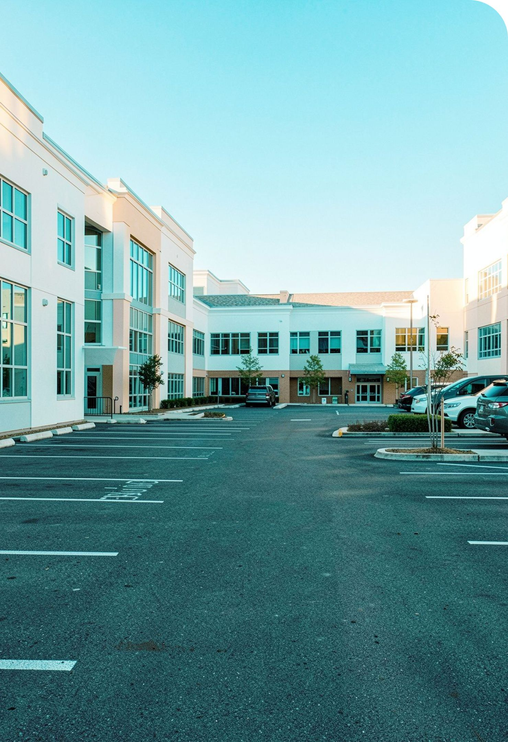
ADVANTAGES, APPLICATIONS, AND LIMITATIONS
Practical benefits with clear current limits
Advantages
Faster record management and better use of available slots.
Applications
Colleges, malls, and offices with a fixed parking area.
Limitations
Fixed capacity of ten slots, fixed rates, and no hardware sensors.
09

Slide 12
FUTURE ENHANCEMENTS AND THANK YOU
Future versions can make parking smarter and connected
Database integration
Sensor-based detection
Real-time availability
Store records in a scalable database.
Detect occupied slots automatically.
Show live vacant slots to drivers.
Mobile app support
Online payments
Check availability and fees from a phone.
Pay parking fees digitally.
10

Slide 13
THANK YOU

